Slide 1
VHDL
VHDL is a language for describing digital hardware used by industry worldwide
  VHDL is an acronym for VHSIC (Very High Speed Integrated Circuit) Hardware Description Language
Developed in the early ’80s
Three versions in common use: VHDL-87, VHDL-93, VHDL-02

Slide 2
VHDL for Synthesis
VHDL for Specification
VHDL for Simulation
VHDL for Synthesis

Slide 3
Outline
Introduction
VHDL Fundamentals
Design Entities
Libraries
Logic, Wires, and Buses
VHDL Design Styles
Introductory Testbenches

Slide 4
Naming and Labeling
VHDL is not case sensitive
  Example:
    Names or labels
      databus
      Databus
      DataBus
      DATABUS
    are all equivalent

Slide 5
Naming and Labeling (cont.)
General rules of thumb (according to VHDL-87)
All names should start with an alphabet character (a-z or A-Z)
Use only alphabet characters (a-z or A-Z) digits (0-9) and underscore (_)
Do not use any punctuation or reserved characters within a name (!, ?, ., &, +, -, etc.)
Do not use two or more consecutive underscore characters (__) within a name (e.g., Sel__A is invalid)
All names and labels in a given entity and architecture must be unique

Slide 6
Free Format
VHDL is a “free format” language
No formatting conventions, such as spacing or indentation imposed by VHDL compilers. Space and carriage return treated the same way.
  Example:
      if (a=b) then
    or
      if (a=b) then
    or
      if (a =
      b) then
    are all equivalent

Slide 7
Comments
Comments in VHDL are indicated with
a “double dash”, i.e., “--”
  Comment indicator can be placed anywhere in the line
  Any text that follows in the same line is treated as a comment
  Carriage return terminates a comment
  No method for commenting a block extending over a couple of lines
Examples:
-- main subcircuit
Data_in <= Data_bus; -- reading data from the input FIFO

Slide 8
Design Entity
design entity
entity declaration
Design Entity - most basic building block of a design
One entity can have
many different architectures
architecture 1
architecture 2
architecture 3

Slide 9
Entity Declaration
Entity Declaration describes the interface of the component, i.e. the input and output ports
Entity name
Port names
Port type
Semicolon
ENTITY nand_gate IS
PORT(
a : IN STD_LOGIC;
b : IN STD_LOGIC;
z : OUT STD_LOGIC
);
END nand_gate;
No Semicolon
Reserved words
Port modes (data flow directions)

Slide 10
Entity Declaration (cont.)
ENTITY entity_name IS
PORT (
port_name : signal_mode signal_type;
port_name : signal_mode signal_type;
………….
port_name : signal_mode signal_type);
END entity_name;

Slide 11
Architecture
Describes an implementation of a design entity
Architecture example:
Simplified syntax:
ARCHITECTURE model OF nand_gate IS
BEGIN
z <= a NAND b;
END model;
ARCHITECTURE architecture_name OF entity_name IS
[ declarations ]
BEGIN
code
END architecture_name;

Slide 12
Entity Declaration and Architecture
nand_gate.vhd
LIBRARY ieee;
USE ieee.std_logic_1164.all;
ENTITY nand_gate IS
PORT(
a : IN STD_LOGIC;
b : IN STD_LOGIC;
z : OUT STD_LOGIC);
END nand_gate;
ARCHITECTURE model OF nand_gate IS
BEGIN
z <= a NAND b;
END model;

Slide 13
Port Modes
Entity
Entity
Port signal
Port signal
z
a
c
Can’t read out
within an entity
Driver resides
outside the entity
Driver resides
inside the entity
Entity
Port signal
Port signal
Entity
x
z
a
Signal X can be
read inside the entity
Signal can be
read inside
the entity
c
Driver resides
inside the entity
Driver may reside both inside and outside of the entity

Slide 14
Port Modes (cont.)
The Port Mode of the interface describes the direction in which data travels with respect to the component
  In: Data comes in this port and can only be read within the entity. It can appear only on the right side of a signal or variable assignment
  Out: The value of an output port can only be updated within the entity. It cannot be read. It can only appear on the left side of a signal assignment
  Inout: The value of a bi-directional port can be read and updated within the entity model. It can appear on both sides of a signal assignment
  Buffer: Used for a signal that is an output from an entity. The value of the signal can be used inside the entity, which means that in an assignment statement the signal can appear on the left and right sides of the <= operator

Slide 15
Library Declarations
IEEE Library declaration
Use all definitions from the package
std_logic_1164
LIBRARY ieee;
USE ieee.std_logic_1164.all;
ENTITY nand_gate IS
PORT(
a : IN STD_LOGIC;
b : IN STD_LOGIC;
z : OUT STD_LOGIC);
END nand_gate;
ARCHITECTURE model OF nand_gate IS
BEGIN
z <= a NAND b;
END model;

Slide 16
Library Declarations (cont.)
LIBRARY library_name;
USE library_name.pkg_name.pkg_parts;

Slide 17
Library Components
LIBRARY
PACKAGE 1
PACKAGE 2
TYPES
CONSTANTS
FUNCTIONS
PROCEDURES
COMPONENTS
TYPES
CONSTANTS
FUNCTIONS
PROCEDURES
COMPONENTS

Slide 18
Common Libraries
IEEE
  Specifies multi-level logic system, including STD_LOGIC, and STD_LOGIC_VECTOR data types
  Needs to be explicitly declared
STD
  Specifies pre-defined data types (BIT, BOOLEAN, INTEGER, REAL, SIGNED, UNSIGNED, etc.), arithmetic operations, basic type conversion functions, basic text i/o functions, etc.
  Visible by default
WORK
  Current designs after compilation
  Visible by default

Slide 19
STD_LOGIC Demystified
LIBRARY ieee;
USE ieee.std_logic_1164.all;
ENTITY nand_gate IS
PORT(
a : IN STD_LOGIC;
b : IN STD_LOGIC;
z : OUT STD_LOGIC);
END nand_gate;
ARCHITECTURE model OF nand_gate IS
BEGIN
z <= a NAND b;
END model;
Hmm?

Slide 20
STD_LOGIC Demystified (cont.)
Value | Meaning
‘X’ | Forcing (Strong driven) Unknown
‘0’ | Forcing (Strong driven) 0
‘1’ | Forcing (Strong driven) 1
‘Z’ | High Impedance
‘W’ | Weak (Weakly driven) Unknown
‘L’ | Weak (Weakly driven) 0. Models a pull down.
‘H’ | Weak (Weakly driven) 1. Models a pull up.
‘-’ | Don't Care
Notes:
Signals are used to connect different parts of a design. They can be thought of as “wire” in conventional sense. Every signal has a type. A type is all the valid values that a signal can assume.
VHDL naturally supports bit type, which allows signals of this (bit) type to take the values ‘0’ or ‘1’.
Signals of type integer can take integer values between +(2³¹ – 1) to -(2³¹-1).
Wire in real implementation may need to take an unknown value, ‘X’ or high impedance value, ‘Z’. Thus, IEEE 1164 standard defined std_logic with nine values listed in Table 1.
Std_logic_vector is an array or vector of std_logic type. It represents a bus and has dimension associated with it, which is known as the range of vector.

Slide 21
Resolving Logic Levels
X 0 1 Z W L H -
X X X X X X X X X
0 X 0 X 0 0 0 0 X
1 X X 1 1 1 1 1 X
Z X 0 1 Z W L H X
W X 0 1 W W W W X
L X 0 1 L W L W X
H X 0 1 H W W H X
- X X X X X X X X

Slide 22
Wires and Buses
SIGNAL a : STD_LOGIC;
SIGNAL b : STD_LOGIC_VECTOR(7 DOWNTO 0);
a
1
wire
b
bus
8

Slide 23
Standard Logic Vectors
SIGNAL a: STD_LOGIC;
SIGNAL b: STD_LOGIC_VECTOR(3 DOWNTO 0);
SIGNAL c: STD_LOGIC_VECTOR(3 DOWNTO 0);
SIGNAL d: STD_LOGIC_VECTOR(7 DOWNTO 0);
SIGNAL e: STD_LOGIC_VECTOR(15 DOWNTO 0);
SIGNAL f: STD_LOGIC_VECTOR(8 DOWNTO 0);
a <= ‘1’;
b <= ”0000”; -- Binary base assumed by default
c <= B”0000”; -- Binary base explicitly specified
d <= ”0110_0111”; -- To increase readability
e <= X”AF67”; -- Hexadecimal base
f <= O”723”; -- Octal base

Slide 24
Vectors and Concatenation
SIGNAL a: STD_LOGIC_VECTOR(3 DOWNTO 0);
SIGNAL b: STD_LOGIC_VECTOR(3 DOWNTO 0);
SIGNAL c, d, e: STD_LOGIC_VECTOR(7 DOWNTO 0);
a <= ”0000”;
b <= ”1111”;
c <= a & b; -- c = ”00001111”
d <= ‘0’ & ”0001111”; -- d <= ”00001111”
e <= ‘0’ & ‘0’ & ‘0’ & ‘0’ & ‘1’ & ‘1’ &
‘1’ & ‘1’; -- e <= ”00001111”

Slide 25
VHDL Design Styles
VHDL Design
Styles
dataflow
structural
behavioral
Concurrent
statements
Components and
interconnects
Sequential statements
Registers
State machines
Test benches
Subset most suitable for synthesis

Slide 26
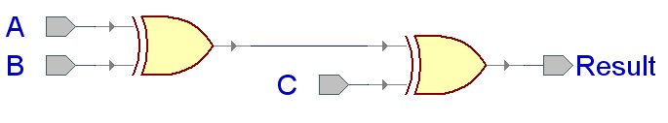
XOR3 Example
ENTITY xor3 IS
PORT(
A : IN STD_LOGIC;
B : IN STD_LOGIC;
C : IN STD_LOGIC;
Result : OUT STD_LOGIC);
end xor3;

Slide 27
Dataflow Descriptions
Describes how data moves through the system and the various processing steps
Dataflow uses series of concurrent statements to realize logic
  Concurrent statements are evaluated at the same time
  Order of these statements doesn’t matter
Dataflow is most useful style when series of Boolean equations can represent a logic

Slide 28
XOR3 Example (cont.)
ARCHITECTURE dataflow OF xor3 IS
SIGNAL U1_out: STD_LOGIC;
BEGIN
U1_out <=A XOR B;
Result <=U1_out XOR C;
END dataflow;
U1_out

Slide 29
Structural Description
Structural design is the simplest to understand
  Closest to schematic capture
  Utilizes simple building blocks to compose logic functions
Components are interconnected in a hierarchical manner
Structural descriptions may connect simple gates or complex, abstract components
Structural style is useful when expressing a design that is naturally composed of sub-blocks

Slide 30
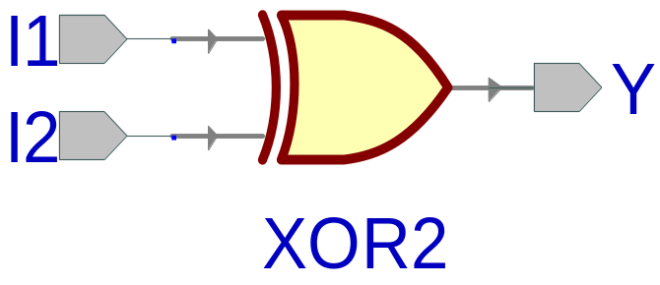
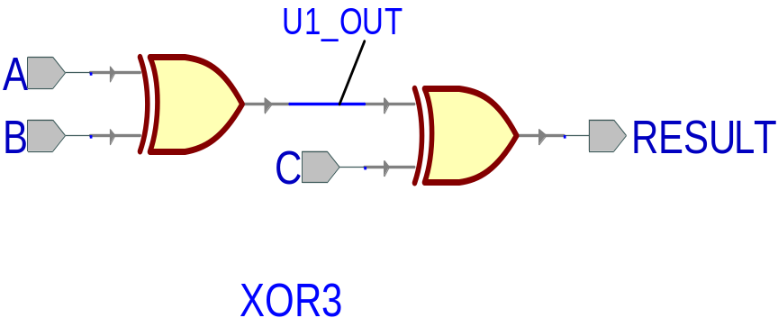
XOR3 Example (cont.)
ARCHITECTURE structural OF xor3 IS
SIGNAL U1_OUT: STD_LOGIC;
COMPONENT xor2 IS
PORT (
I1 : IN STD_LOGIC;
I2 : IN STD_LOGIC;
Y : OUT STD_LOGIC);
END COMPONENT;
BEGIN
U1: xor2 PORT MAP (I1 => A,
I2 => B,
Y => U1_OUT);
U2: xor2 PORT MAP (I1 => U1_OUT,
I2 => C,
Y => Result);
END structural;
A
B
XOR3
Result
C

Slide 31
Component and Instantiation
Named association connectivity (recommended)
Positional association connectivity (not recommended)
COMPONENT xor2 IS
PORT(
I1 : IN STD_LOGIC;
I2 : IN STD_LOGIC;
Y : OUT STD_LOGIC
);
END COMPONENT;
U1: xor2 PORT MAP (I1 => A,
I2 => B,
Y => U1_OUT);
COMPONENT xor2 IS
PORT(
I1 : IN STD_LOGIC;
I2 : IN STD_LOGIC;
Y : OUT STD_LOGIC
);
END COMPONENT;
U1: xor2 PORT MAP (A, B, U1_OUT);

Slide 32
Behavioral Description
Accurately models what happens on the inputs and outputs of the black box
Uses PROCESS statements in VHDL
ARCHITECTURE behavioral OF xor3 IS
BEGIN
xor3_behave: PROCESS (A,B,C)
BEGIN
IF ((A XOR B XOR C) = '1') THEN
Result <= '1';
ELSE
Result <= '0';
END IF;
END PROCESS xor3_behave;
END behavioral;

Slide 33
Testbenches
Testbench
Processes
Generating
Stimuli
Design Under Test (DUT)
Observed Outputs

Slide 34
Testbench Definition
Testbench applies stimuli (drives the inputs) to the Design Under Test (DUT) and (optionally) verifies expected outputs
The results can be viewed in a waveform window or written to a file
Since Testbench is written in VHDL, it is not restricted to a single simulation tool (portability)
The same Testbench can be easily adapted to test different implementations (i.e. different architectures) of the same design

Slide 35
Testbench Anatomy
ENTITY tb IS
--TB entity has no ports
END tb;
ARCHITECTURE arch_tb OF tb IS
--Local signals and constants
COMPONENT TestComp --All DUT component declarations
PORT ( );
END COMPONENT;
-----------------------------------------------------
BEGIN
testSequence: PROCESS -- Input stimuli
END PROCESS;
DUT:TestComp PORT MAP(); -- Instantiations of DUTs
END arch_tb;
Notes:
Internal signals are from DUT.
Main process may be split into main process. I.e. one to drive clk, rst and other for test vectors.
Many architectures can be tested by inserting more
for DUT:TestComp use entity work.TestComp(archName) statmetns
“work” is the name of the library that “TestComp” is being compiled to.
The “DUT” tag is required.

Slide 36
Testbench for XOR3
LIBRARY ieee;
USE ieee.std_logic_1164.all;
ENTITY xor3_tb IS
END xor3_tb;
ARCHITECTURE xor3_tb_architecture OF xor3_tb IS
COMPONENT xor3
PORT(
A : IN STD_LOGIC;
B : IN STD_LOGIC;
C : IN STD_LOGIC;
Result : OUT STD_LOGIC );
END COMPONENT;
-- Stimulus signals - mapped to the input and inout ports of tested entity
SIGNAL test_vector: STD_LOGIC_VECTOR(2 DOWNTO 0);
SIGNAL test_result : STD_LOGIC;

Slide 37
Testbench for XOR3 (cont.)
BEGIN
UUT : xor3
PORT MAP (
A => test_vector(0),
B => test_vector(1),
C => test_vector(2),
Result => test_result);
Testing: PROCESS
BEGIN
test_vector <= "000";
WAIT FOR 10 ns;
test_vector <= "001";
WAIT FOR 10 ns;
test_vector <= "010";
WAIT FOR 10 ns;
…
…
test_vector <= "011";
WAIT FOR 10 ns;
test_vector <= "100";
WAIT FOR 10 ns;
test_vector <= "101";
WAIT FOR 10 ns;
test_vector <= "110";
WAIT FOR 10 ns;
test_vector <= "111";
WAIT FOR 10 ns;
END PROCESS;
END xor3_tb_architecture;

Slide 38
What is a Process?
  A process is a sequence of instructions referred
  to as sequential statements
The keyword PROCESS
A process can be given a unique name using an optional LABEL
This is followed by the keyword PROCESS
The keyword BEGIN is used to indicate the start of the process
All statements within the process are executed SEQUENTIALLY. Hence, order of statements is important
A process must end with the keywords END PROCESS
Testing: PROCESS
BEGIN
test_vector<=“00”;
WAIT FOR 10 ns;
test_vector<=“01”;
WAIT FOR 10 ns;
test_vector<=“10”;
WAIT FOR 10 ns;
test_vector<=“11”;
WAIT FOR 10 ns;
END PROCESS;

Slide 39
Process Execution
Testing: PROCESS
BEGIN
test_vector<=“00”;
WAIT FOR 10 ns;
test_vector<=“01”;
WAIT FOR 10 ns;
test_vector<=“10”;
WAIT FOR 10 ns;
test_vector<=“11”;
WAIT FOR 10 ns;
END PROCESS;
The execution of statements continues sequentially till the last statement in the process
After execution of the last statement, the control is again passed to the beginning of the process
Order of execution
Program control is passed to the first statement after BEGIN

Slide 40
WAIT Statements
The last statement in the PROCESS is a WAIT instead of WAIT FOR 10 ns
This will cause the PROCESS to suspend indefinitely when the WAIT statement is executed
This form of WAIT can be used in a process included in a testbench when all possible combinations of inputs have been tested or a non-periodical signal has to be generated
Testing: PROCESS
BEGIN
test_vector<=“00”;
WAIT FOR 10 ns;
test_vector<=“01”;
WAIT FOR 10 ns;
test_vector<=“10”;
WAIT FOR 10 ns;
test_vector<=“11”;
WAIT;
END PROCESS;
Order of execution
Program execution stops here

Slide 41

WAIT FOR vs. WAIT
WAIT FOR: waveform will keep repeating itself forever
…
0
1
2
3
0
1
2
3
WAIT: waveform will keep its state after the last wait instruction.
…

Slide 42
Loop Statement
Loop Statement
Repeats a Section of VHDL Code
  Example: process every element in an array in the same way
FOR i IN range LOOP
statements
END LOOP;

Slide 43
Loop Statement Example
Testing: PROCESS
BEGIN
test_vector<="000";
FOR i IN 0 TO 7 LOOP
WAIT FOR 10 ns;
test_vector<=test_vector+”001";
END LOOP;
END PROCESS;

Slide 44
Loop Statement Example (cont.)
Testing: PROCESS
BEGIN
test_ab<="00";
test_sel<="00";
FOR i IN 0 TO 3 LOOP
FOR j IN 0 TO 3 LOOP
WAIT FOR 10 ns;
test_ab<=test_ab+"01";
END LOOP;
test_sel<=test_sel+"01";
END LOOP;
END PROCESS;

Slide 45
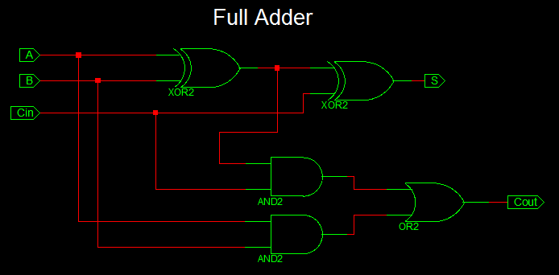

Slide 46
VHDL Code for Full Adder
view sourceprint?
library IEEE;
use IEEE.STD_LOGIC_1164.ALL;
entity full_adder_vhdl_code is
Port ( A : in STD_LOGIC;
B : in STD_LOGIC;
Cin : in STD_LOGIC;
S : out STD_LOGIC;
Cout : out STD_LOGIC);
end full_adder_vhdl_code;
architecture gate_level of full_adder_vhdl_code is
begin
S <= A XOR B XOR Cin ;
Cout <= (A AND B) OR (Cin AND A) OR (Cin AND B) ;
end gate_level;

Slide 47
Testbench VHDL Code for Full Adder
view sourceprint?
LIBRARY ieee;
USE ieee.std_logic_1164.ALL;
ENTITY Testbench_full_adder IS
END Testbench_full_adder;
ARCHITECTURE behavior OF Testbench_full_adder IS
-- Component Declaration for the Unit Under Test (UUT)
COMPONENT full_adder_vhdl_code
PORT(
A : IN std_logic;
B : IN std_logic;
Cin : IN std_logic;
S : OUT std_logic;
Cout : OUT std_logic
);
END COMPONENT;
--Inputs
signal A : std_logic := '0';
signal B : std_logic := '0';
signal Cin : std_logic := '0';
--Outputs
signal S : std_logic;
signal Cout : std_logic;
BEGIN
-- Instantiate the Unit Under Test (UUT)
uut: full_adder_vhdl_code PORT MAP (
A => A, B => B, Cin => Cin, S => S,
Cout => Cout
);

